Slide 1






Beginner’s Guide to Containers and Orchestration
Why Containers?
Beginner’s Guide to Containers and Orchestration

Slide 2



Why Containers?
Containers are a powerful tool! They have had a tremendous impact on how the industry does IT. They can help you to:
Move Faster
Automate More
Increase Reliability
For Less Money
Beginner’s Guide to Containers and Orchestration

Slide 3

Beginner’s Guide to Containers and Orchestration
Course Introduction
Beginner’s Guide to Containers and Orchestration

Slide 4

Beginner’s Guide to Containers and Orchestration
Welcome to Beginners Guide to Containers and Orchestration!
This course is a non-technical introduction to the concepts of containers and container orchestration. If you want to know what containers are and how they can help you, you are in the right place!
This course will cover:
What containers and container orchestration are.
Popular tools and buzzwords related to containers and orchestration, like Docker and Kubernetes.
How containers can provide you with business value.
How containers can be used in the cloud.
Beginner’s Guide to Containers and Orchestration

Slide 5

Beginner’s Guide to Containers and Orchestration
Course Features and Tools
Beginner’s Guide to Containers and Orchestration

Slide 6

Beginner’s Guide to Containers and Orchestration
What are Containers?
Beginner’s Guide to Containers and Orchestration

Slide 7

What are Containers?
Containers are all about portable software.
They are a technology that allows you to run software on a variety of systems, including a developer’s laptop, all the way to a production system.
This speeds up deployment, simplifies automation, and ensures your code can run consistently in production, as well as everywhere else!
Like virtual machines, containers wrap your software in a standardized environment that allows it to run consistently on varied machines.
But containers are smaller, use fewer resources, and are easier to automate than virtual machines.
Beginner’s Guide to Containers and Orchestration

Slide 8
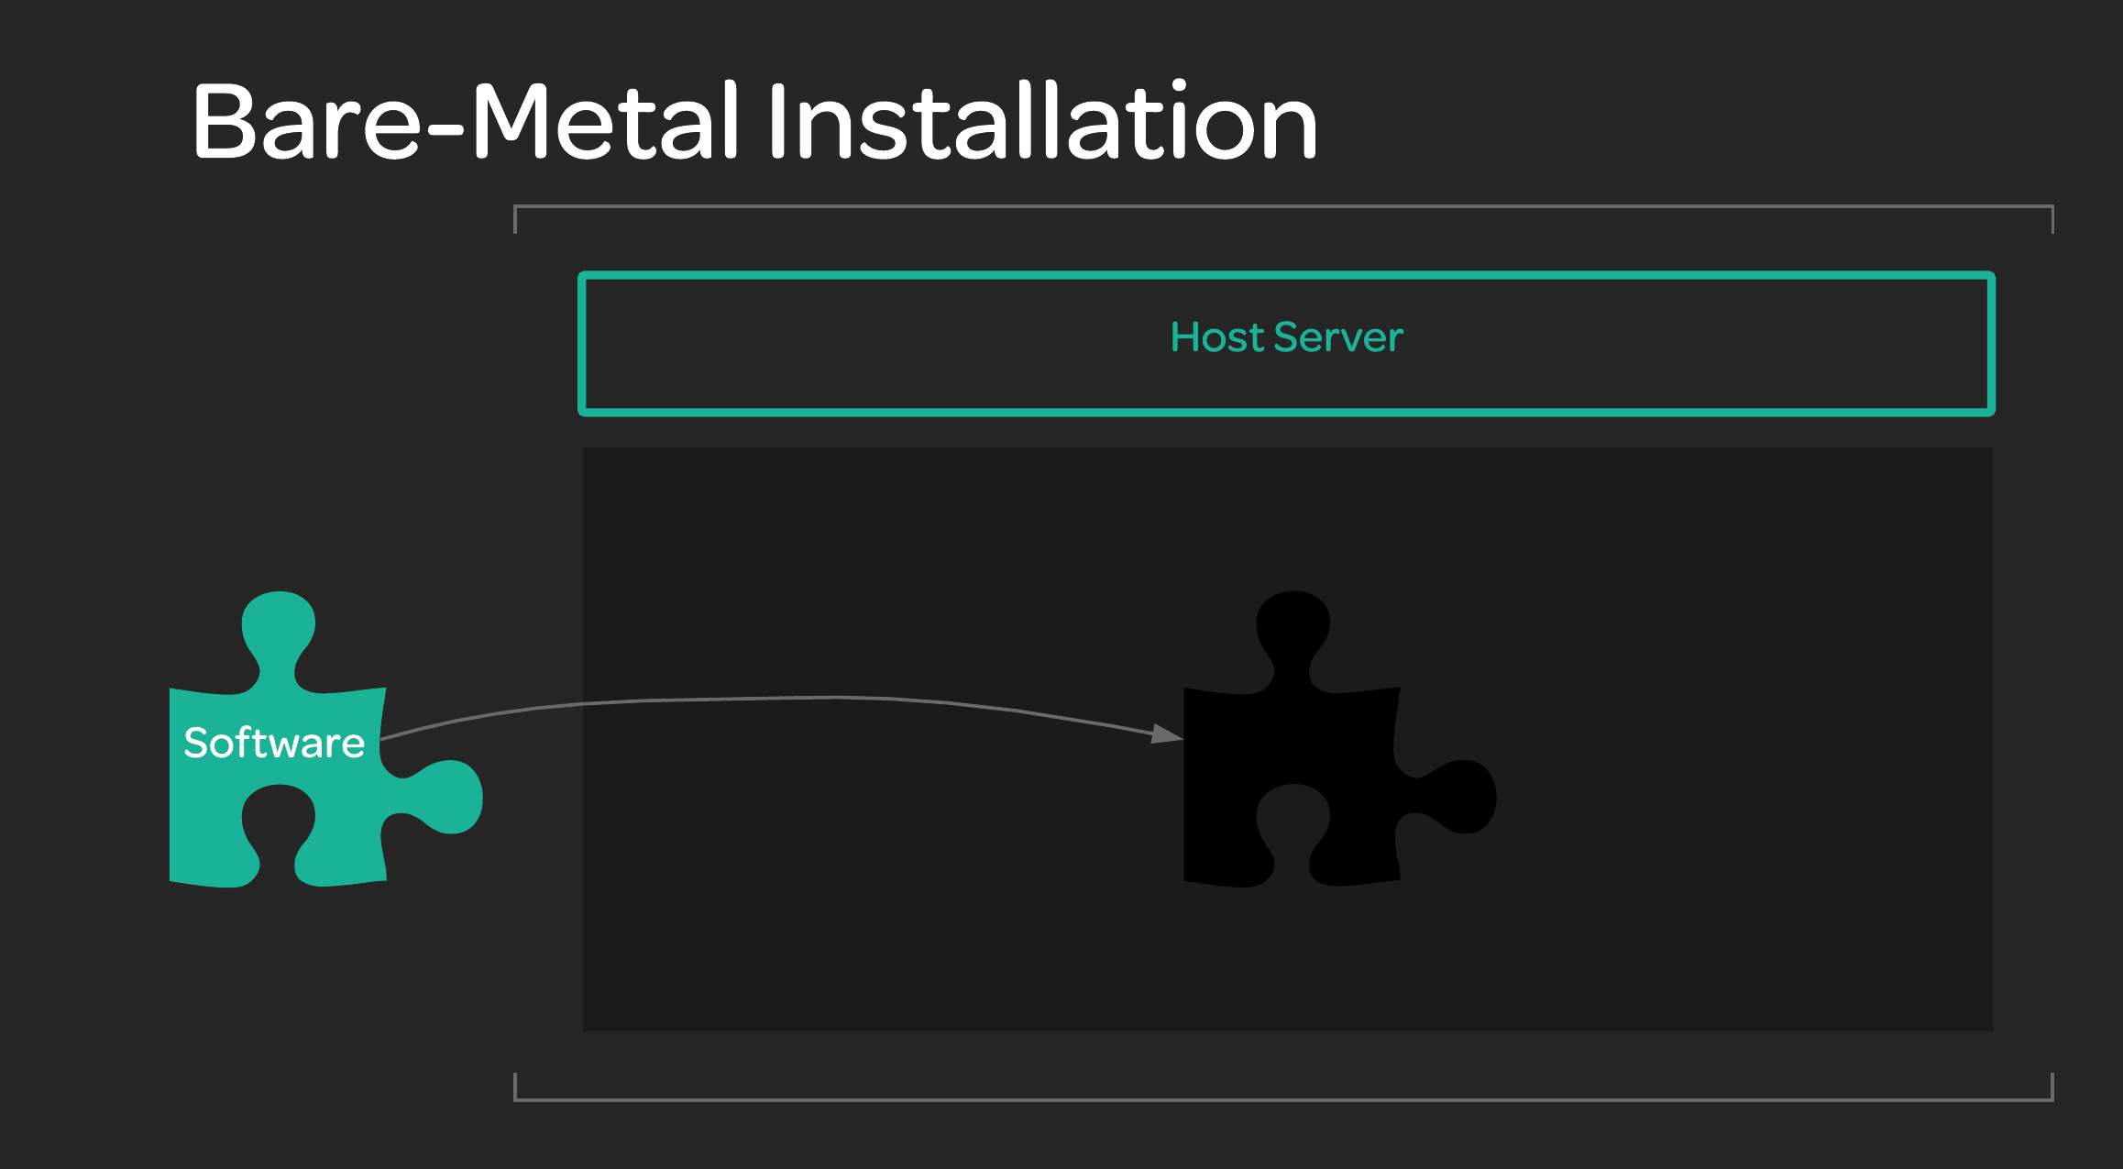
Beginner’s Guide to Containers and Orchestration

Slide 9
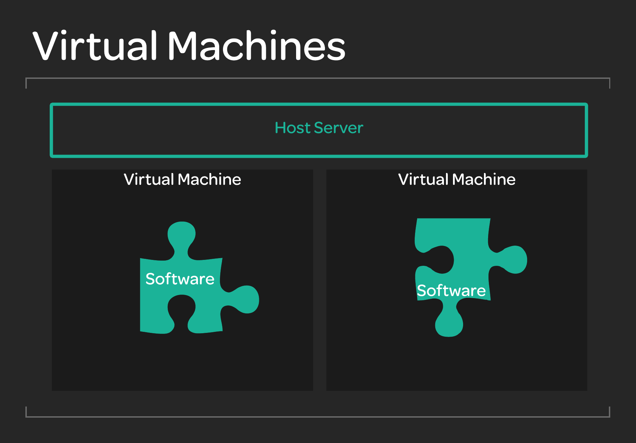
Beginner’s Guide to Containers and Orchestration

Slide 10
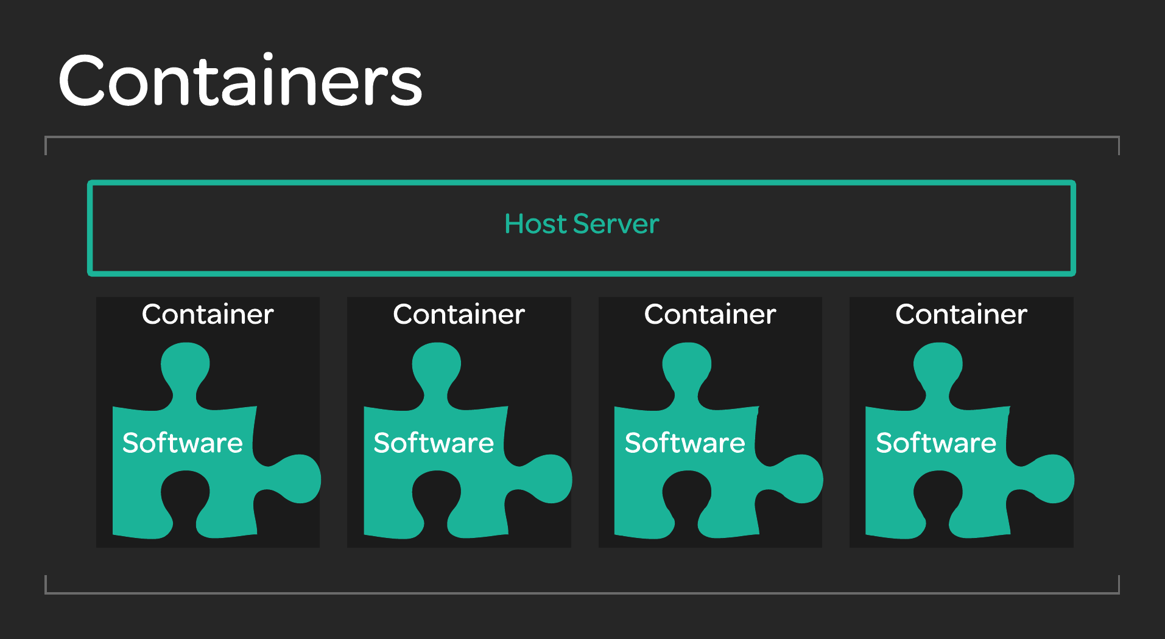
Beginner’s Guide to Containers and Orchestration

Slide 11
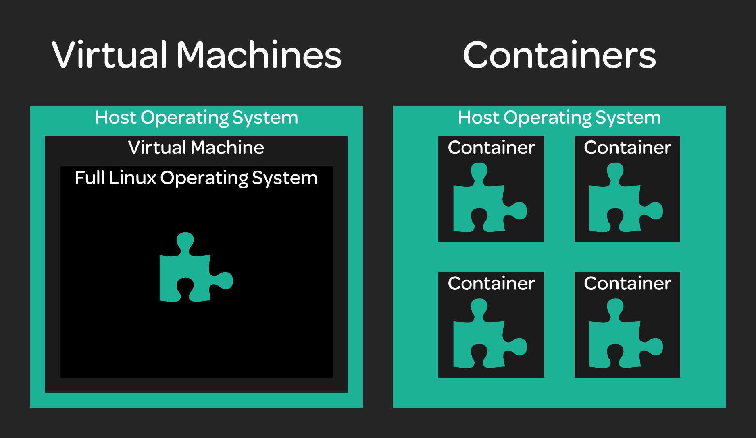
Beginner’s Guide to Containers and Orchestration

Slide 12

Beginner’s Guide to Containers and Orchestration
What is Orchestration?
Beginner’s Guide to Containers and Orchestration

Slide 13

What is Orchestration?
Container Orchestration simply refers to processes used to manage containers and to automate the management of containers.
For example:
I want to start up a set of five containers in production.
I could spin up each container manually.
Or, I could tell an orchestration tool like Kubernetes that I want five containers, and let the tool do it.
For the sake of redundancy, it’s a good idea to spin up my five containers on five different hosts.
The more complex my requirements for managing containers become, the more useful my orchestration tools become!
Beginner’s Guide to Containers and Orchestration

Slide 14

Another Example: Zero-Downtime Deployments
In the old days, deployments went like this:
Take the server down for maintenance (it is unavailable to customers).
Perform the deployment.
Bring the server back up.
A zero-downtime deployment (with containers) goes like this:
Spin up containers running the new code.
When they are fully up, direct user traffic to the new containers.
Remove the old containers running the old code. No downtime for users!
How do you coordinate those steps quickly and efficiently? Orchestration tools can do it for you!
Beginner’s Guide to Containers and Orchestration

Slide 15

Beginner’s Guide to Containers and Orchestration
What are Containers Used For?
Beginner’s Guide to Containers and Orchestration

Slide 16

What are Containers Used For?
This lesson is just a preview to get you thinking about how you might want to use containers. Check out the section on use cases for more details on how they can be used!
Containers are great at accomplishing things like:
Software Portability – Running software consistently on different machines.
Isolation – Keeping individual pieces of software separate from one another.
Scaling – Increasing or decreasing resources allocated to software as needed.
Automation – Automating processes to save time and money.
Efficient Resource Usage – Containers use resources efficiently, which saves money.
Beginner’s Guide to Containers and Orchestration

Slide 17

Beginner’s Guide to Containers and Orchestration
Advantages and Limitations of Containers
Beginner’s Guide to Containers and Orchestration

Slide 18

Advantages of Containers
These are a few of the main advantages of containers:
The isolation and portability of VMs.
More lightweight then VMs - Less resource usage.
Faster than VMs – Containers can start up in seconds, not minutes.
Smaller than VMs – Container images can be measured in megabytes, not gigabytes.
All of these add up to faster and simpler automation!
Beginner’s Guide to Containers and Orchestration

Slide 19

Limitations of Containers
These are some limitations of containers:
Less flexibility than VMs – You can’t run a Windows container on a Linux machine (yet).
Introduces new challenges around orchestration and automation.
Beginner’s Guide to Containers and Orchestration

Slide 20

Beginner’s Guide to Containers and Orchestration
What is Docker
Beginner’s Guide to Containers and Orchestration

Slide 21

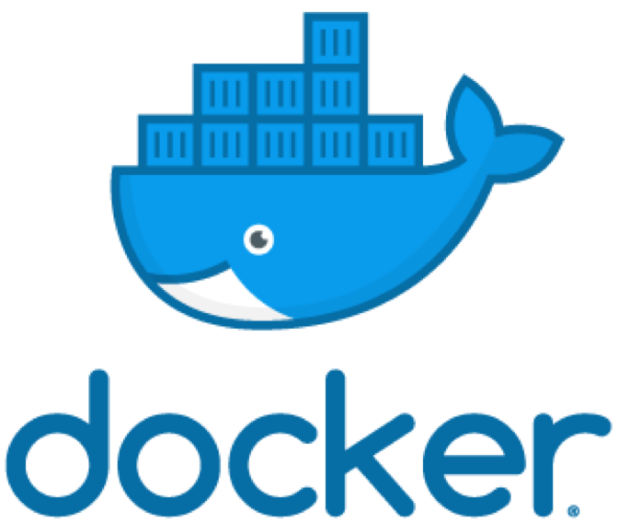
Docker
Docker is primarily a container runtime.
This means that Docker is a piece of software that is designed to implement and support containers.
At its core, Docker allows you to run containers on systems. It also offers a variety of tools for creating and managing containers and container images.
It is currently the industry leader in container runtimes.
Check out the Docker official site for documentation and more info! https://www.docker.com/
Beginner’s Guide to Containers and Orchestration

Slide 22

Beginner’s Guide to Containers and Orchestration
What About Other Container Runtimes?
Beginner’s Guide to Containers and Orchestration

Slide 23

Container Runtimes
Docker is not the only option for doing containers!
Here are other competitive container runtimes:
rkt
Created by CoreOS, “designed with composability and security in mind.” https://coreos.com/rkt/
containerd
Emphasizes “simplicity, robustness, and portability.” https://containerd.io/
Beginner’s Guide to Containers and Orchestration

Slide 24

Beginner’s Guide to Containers and Orchestration
What is Kubernetes?
Beginner’s Guide to Containers and Orchestration

Slide 25

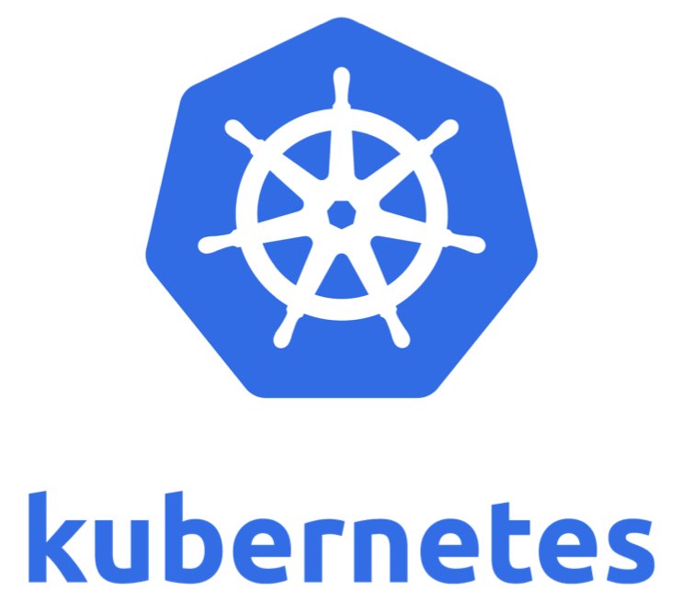
Kubernetes
Kubernetes is a container orchestration tool.
It allows you to easily build and manage your container infrastructure and automation.
Do you want things like self-healing applications, automated scaling, and easy automated deployments? Then you should definitely look into Kubernetes!
Check out the official Kubernetes site for documentation and additional info! https://kubernetes.io/
Beginner’s Guide to Containers and Orchestration

Slide 26

Beginner’s Guide to Containers and Orchestration
What About Other Orchestration Solutions?
Beginner’s Guide to Containers and Orchestration

Slide 27

Container Orchestration Solutions
Kubernetes is not the only container orchestration tool!
Here are some other popular ones:
Docker Swarm
Docker’s native container orchestration solution. https://docs.docker.com/engine/swarm/
Marathon
Based on Apache Mesos, offers APIs for integrating with other tools. https://mesosphere.github.io/marathon/
Nomad
Open source and built by HashiCorp, designed to be simple and lightweight. https://www.nomadproject.io/
Beginner’s Guide to Containers and Orchestration

Slide 28

Cloud Orchestration Solutions
Cloud providers such as Amazon Web Services, Microsoft Azure, and Google Cloud Platform also offer built-in container orchestration solutions, including cloud-native Kubernetes implementations!
For example:
Amazon Elastic Container Service https://aws.amazon.com/ecs/
Amazon ECS for Kubernetes https://aws.amazon.com/eks/
Azure Kubernetes Service
https://azure.microsoft.com/en-us/services/kubernetes-service/
Google Kubernetes Engine
https://cloud.google.com/kubernetes-engine/
Beginner’s Guide to Containers and Orchestration

Slide 29

Beginner’s Guide to Containers and Orchestration
Microservices
Beginner’s Guide to Containers and Orchestration

Slide 30
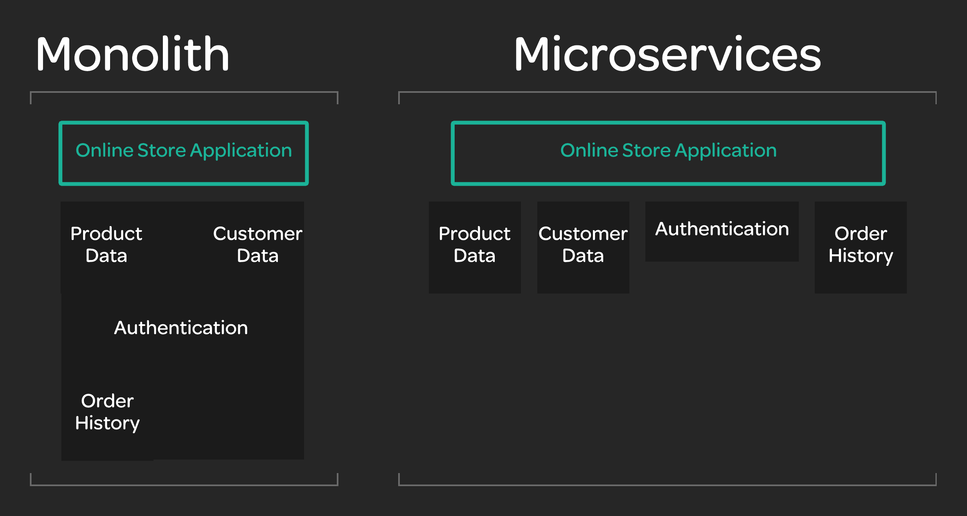

What are Microservices?
Microservices are a type of
application architecture that
involves splitting the application
into a series of small, independent
services.
Microservices can be built,
modified, and scaled separately,
with relatively little impact on one another.
Beginner’s Guide to Containers and Orchestration

Slide 31

Containers and Microservices
Containers excel when it comes to managing a large number of small, independent workloads.
Containers and orchestration make it easier to manage and automate the process of deploying, scaling, and connecting lots of microservice instances.
For example, I may have one microservice that needs additional resources. With containers, all I need to do is create more containers for that service to handle the load. With orchestration, that can even be
done automatically and in real time!
Beginner’s Guide to Containers and Orchestration

Slide 32

Beginner’s Guide to Containers and Orchestration
Cloud Transformation
Beginner’s Guide to Containers and Orchestration

Slide 33

What is Cloud Transformation?
Cloud transformation is the process of migrating your existing IT infrastructure to the cloud.
Many companies today are making the transition away from locally-hosted services and toward services hosted in the cloud.
However, moving your infrastructure into the cloud can come with challenges.
Beginner’s Guide to Containers and Orchestration

Slide 34

Containers and Cloud Transformation
Containers can help you move into the cloud. It is relatively easy to wrap existing software in containers. While containers may not be the answer for every type of existing software, they are a powerful tool.
Using containers in the cloud to run your software can allow you to take advantage of the flexibility and automatability of containers.
Since containers use fewer resources than virtual machines, you can save money on cloud resources!
Beginner’s Guide to Containers and Orchestration

Slide 35

Beginner’s Guide to Containers and Orchestration
Automated Scaling
Beginner’s Guide to Containers and Orchestration

Slide 36

What is Automated Scaling?
Automated Scaling refers to automatically provisioning resources in response to real-time data metrics.
Without automated scaling, you must provision enough resources to cover your peak resource needs at all times.
If I need 10 servers to handle my peak usage times, then I need 10 servers all the time!
With automated scaling, you can automatically detect (or even predict) increase in usage. The
automated system creates new servers to handle the peak usage time, then removes those servers when usage returns to normal levels.
Beginner’s Guide to Containers and Orchestration

Slide 37

Containers and Automated Scaling
Automated scaling depends on the ability to spin up new instances quickly and efficiently.
Since containers are small and can start up quickly, they are ideal for this purpose. This means that if the system detects an increase in usage, it can spin up new containers in a few seconds.
This increases stability and reduces cost! Your users see less downtime due to high loads, and you don’t use (and pay for) resources unnecessarily!
Beginner’s Guide to Containers and Orchestration

Slide 38

Beginner’s Guide to Containers and Orchestration
Continuous Deployment Pipelines
Beginner’s Guide to Containers and Orchestration

Slide 39

What is Continuous Deployment?
Continuous Deployment is the practice of deploying new code automatically and frequently.
Instead of writing new code for months and doing a big deployment, continuous deployment means constantly doing many small deployments. Some companies even do multiple deployments a day!
This allows you to get new functionality in front of customers faster, and it also reduces the risk associated with big deployments containing a large number of changes.
To maintain stability while doing continuous deployment, it is important to make use of automation to ensure that
deployments are stable and consistent.
Beginner’s Guide to Containers and Orchestration

Slide 40

Containers and Continuous Deployment
Containers work very well in the context of continuous deployment.
They make it easy to test code in an environment that is the same as production, because the code can be automatically tested inside the container itself.
An automation pipeline for continuous delivery can automatically build a container image with the new code, test it, then automatically ship that same container image production.
Because the production environment (the container) is built right into this automated process, developers even have the ability to use it for testing and troubleshooting.
Beginner’s Guide to Containers and Orchestration

Slide 41

Beginner’s Guide to Containers and Orchestration
Self-Healing Applications
Beginner’s Guide to Containers and Orchestration

Slide 42

What are Self-Healing Applications?
Self-Healing Applications are applications that are able to automatically detect when something is
broken and automatically take steps to correct the problem without the need for human involvement.
System administrators will tell you that, in the past, it was often very common to have to wake up in the middle of the night to reboot a server.
What if an automated system could detect a problem and reboot the server automatically? That’s an example of self-healing!
Beginner’s Guide to Containers and Orchestration

Slide 43

Containers and Self-Healing Applications
Since Containers start up quickly, it’s easy enough to automatically restart them.
However, containers take the concept of rebooting the server a step farther.
Since it is so quick and easy to start up new container instances, when something goes wrong with a container it can often be easily destroyed and replaced within a few seconds.
That means that if something goes wrong, you can have a brand new, clean, working instance quickly replace the
broken one!
Beginner’s Guide to Containers and Orchestration

Slide 44

Beginner’s Guide to Containers and Orchestration
Developer Visibility
Beginner’s Guide to Containers and Orchestration

Slide 45

Developer Visibility
In more traditional environments, it can be difficult for everyone to get access to a production system to troubleshoot when something goes wrong.
That may be due to security concerns, or simply due to the fact that when something goes wrong, the first priority is to fix it as quickly as possible, not to find out why it happened.
Anyone in the organization that does not have direct access to a production system has no idea why code may or may not be working in production.
This leads to the constant refrain, “Well, it works on my machine!”
Beginner’s Guide to Containers and Orchestration

Slide 46

Containers and Visibility
With Containers, the container is the production environment.
This means that anyone can spin up an environment that is exactly like production, even on their own laptop.
Developers (and others) have the ability to test their code and see exactly how it will behave in production.
The additional visibility offered by containers can help your organization develop and troubleshoot code much
more efficiently!
Beginner’s Guide to Containers and Orchestration

Slide 47

Beginner’s Guide to Containers and Orchestration
Doing Containers in the Cloud
Beginner’s Guide to Containers and Orchestration

Slide 48

What is the Cloud?
The Cloud can be an ambiguous term, but it usually just means “someone else’s computer.”
Instead of running software and hosting services in your own datacenter, being in the cloud means that you are running software in a remote datacenter over the internet.
Typically, this means that you pay a cloud provider such as Amazon (AWS), Microsoft (Azure), or Google (GCP), and they provide you with servers and resources with which to run your software.
The term “cloud” can also refer to running software in your own
datacenter using the tools and practices that are associated with the cloud. This is sometimes called private cloud.
Beginner’s Guide to Containers and Orchestration

Slide 49

What Does it Mean to do Containers in the Cloud?
There are many ways to run software in the cloud. This includes running containers on servers hosted by a cloud provider.
Doing containers in the cloud simply means that you are running containers on servers in the cloud.
Most cloud providers, including Amazon Web Services, Microsoft Azure, and Google Cloud Platform, provide services which are specifically designed around containers, offering you the ability to run
containers in the cloud quickly and easily.
Beginner’s Guide to Containers and Orchestration

Slide 50

Beginner’s Guide to Containers and Orchestration
The Benefits of Containers in the Cloud
Beginner’s Guide to Containers and Orchestration

Slide 51

Why do Containers in the Cloud?
Containers are just one way to run software in the cloud.
Some of the benefits of using containers in the cloud are:
Regular Benefits of Containers
You get all the normal benefits of containers in terms of portability, speed, and ease of automation.
Save Money
Since containers are lightweight and have little overhead, they can help save on cloud costs. With
cloud providers, you only pay for the resources you use. Use less resources, pay less
Cloud Platforms Offer Container Support out of the Box
Most cloud platforms provide services built specifically for containers.
Beginner’s Guide to Containers and Orchestration

Slide 52
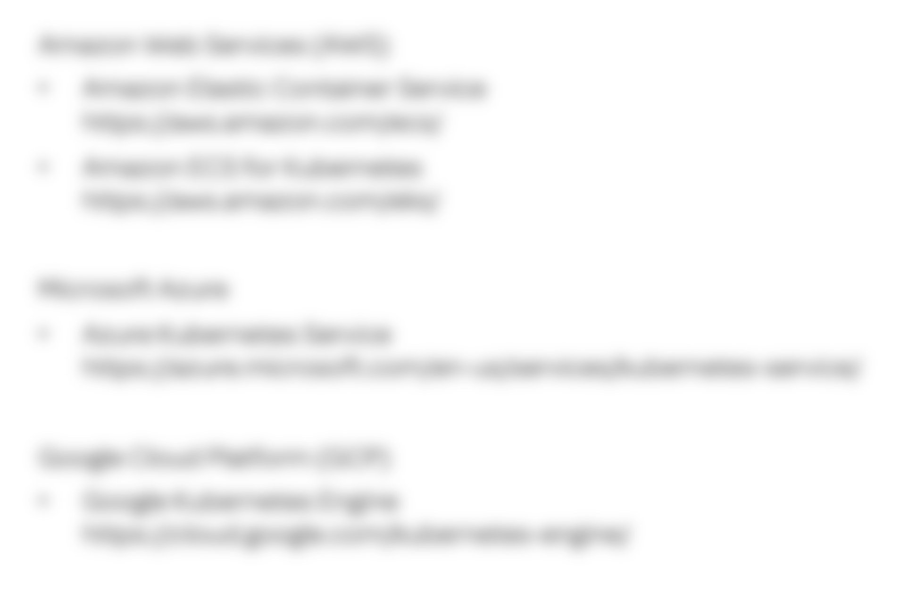
The “Big Three” Cloud Platforms and Containers
Amazon Web Services (AWS)
Amazon Elastic Container Service https://aws.amazon.com/ecs/
Amazon ECS for Kubernetes https://aws.amazon.com/eks/
Microsoft Azure
Azure Kubernetes Service
https://azure.microsoft.com/en-us/services/kubernetes-service/
Google Cloud Platform (GCP)
Google Kubernetes Engine
https://cloud.google.com/kubernetes-engine/
Beginner’s Guide to Containers and Orchestration

Slide 53

Beginner’s Guide to Containers and Orchestration
Next Steps
Beginner’s Guide to Containers and Orchestration

Slide 54

Congratulations!
You have completed Beginner’s Guide to Containers and Orchestration!
If you are interested in learning more about these topics from a technical perspective, check out these great Linux Academy courses: Containers
LXC/LXD Deep Dive
CoreOS Essentials Docker
Docker Quick Start
Docker Deep Dive
Docker Certified Associate Prep Course Kubernetes
Certified Kubernetes Administrator (CKA)
Kubernetes the Hard Way DevOps
DevOps Essentials
Implementing a Full CI/CD Pipeline
Beginner’s Guide to Containers and Orchestration

